Slide 1

JMS Java Message Service
Date : Nov 14, 2016
Chandra Vir Singh – Crew Pay

Slide 2

Agenda
Introduction to JMS
JMS vs EMAIL
Features
JMS Application
JMS Components
MOM service Provider
Messaging Models
JMS API Programing model
Message consumption Types

Slide 3
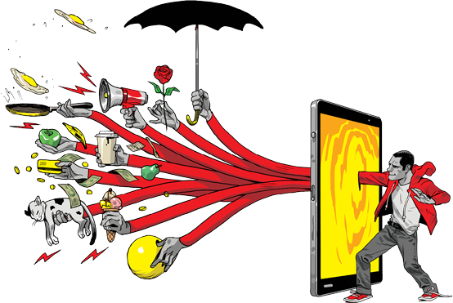
What is Message AND Messaging ?
A Message : A Message has been described in various ways by different specification.
However it is an entity f the communication. It is bytes of data that is meaning full between the application which use it. Message are used to transfer information from one application to other ones which may or may not run in same platform .
Messaging : Messaging is communication between system component or different application (In a distributed environment) which are loosely coupled unlike its peers like TCP sockets, CORBA or RMI.
Advantage of messaging : The advantages of java messaging include the ability to integrate different platform, reduce system bottlenecks, increase scalability and reliability of message delivery.

Slide 4
What is JMS ?
The Java Message service (JMS) is a Java Message Oriented Middleware (MOM) API for sending message between two or more clients. JMS is a part of the java Enterprises Edition.
An application can communicate with any number of applications using JMS. This communication is loosely coupled. Instead , those application are communicated by connecting to a common destination.
A specification that describe a common way for Java program to create, send, receive and read distributed enterprises message.
Loosely coupled communication
Asynchronous Messaging
Reliable Delivery
A message is guaranteed to be delivered once and only once.
Client 1
Message
Client 2
Destination
Message

Slide 5
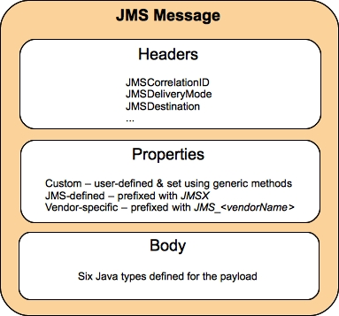
JMS Messages
Message Header
Used for identifying and routing messages
Contains vendor-specified values, but could also contain application-specific data
Typically name/value pairs
Message Properties (optional)
Message Body(optional)
contains the data
five different message body types in the JMS specification
Message Type | Contains | Some Methods
TextMessage | String | getText, setText
MapMessage | set of name/value pairs | setString, setDouble, setLong, getDouble, getString
BytesMessage | stream of uninterpreted bytes | writeBytes, readBytes
StreamMessage | stream of primitive values | writeString, writeDouble, writeLong, readString
Object Message | serialize object | setObject, getObject

Slide 6
JMS Vs Java Mail
Java Mail | JMS
Java mail is an API for sending emails, emails with attachment, reading emails, etc. | The JMS is the java Messaging service which is capable of exchanging message between applications.
Mainly human to human information exchange. | Inter and Intra company “Application /Human to Application/Human messaging” e.g.. Chat it stock ticker
Delivery can be duplicate or nor guaranteed. | JMS id more like a database –the message (can be configured) to be drained if and only if the recipient system reads it. In other word the delivery can be guaranteed.
Its not a big deal to get multiple copies of an email(which you many get if I loose a connection with an email server over POP for example) | Can turn out to a disaster when we receive 2 copies of same mail.
Email is designed for connectivity on the web | JMS has a bunch of different qualities of service (queue v topic) designed for very high performance messaging with low latency together with reliability avoiding duplicates and message loss.

Slide 7
System Coupling
TIGHT: Systems that are very rigid in their requirements
System 2 MUST respond to a message before System 1 can proceed to the next activity
LOOSE: Where programmers just send a message and can be assure the infrastructure will do whatever it needs to do send the message
System 1
System 2
Tight Coupling
System 1
System 2
Loose Coupling

Slide 8
Tightly Coupled Communications
System 1
System 2
Unreliable Network
Sender needs a remote service and calls a remote procedure call
The sending process “Stops” and waits for a reply
Synchronous messaging – don’t proceed till we are synchronized up
The sender will “freeze” if the network is down or the sender will have to manually keep trying till the remote system is up and it gets a response
Remote procedure call (RPC), Java Remote Method Invocation (RMI)

Slide 9
Loosely Coupled Communications
System 1
System 2
Unreliable Network
Message Queue
Message Queue
Programmers just “fire and forget”
There is no “blocking” of sender’s process
System 1 just gets a reply message when the data request has been received
System can transmit messages to remote systems even when the remote system is down or the network has failed. Messages wait patiently in the queue till the network is back up.
System administrators can monitor the message queues and be notified of congestions
High priority messages can take precedence over large, batch transfers

Slide 10
Message Consumptions
Messaging products are inherently asynchronous: There is no fundamental timing dependency between the production and the consumption of a message. However, the JMS specification uses this term in a more precise sense. Messages can be consumed in either of two ways:
Synchronously: A subscriber or a receiver explicitly fetches the message from the destination by calling the receive method. The receive method can block until a message arrives or can time out if a message does not arrive within a specified time limit.
Asynchronously: A client can register a message listener with a consumer. A message listener is similar to an event listener. Whenever a message arrives at the destination, the JMS provider delivers the message by calling the listener’s on Message method, which acts on the contents of the message.
Synchronous Producer
Synchronous producer has two queues: a send queue and a reply queue. The send queue is the queue on which the producer will send a message to the consumer. The reply queue is the queue on which the producer will listen for a reply from the consumer. The producer when it sends a message sets two important pieces of information on the message:
JMSCorrelationID: This is the uniqueID used by the producer to identify the message
JMSReplyTo: This tells the consumer on which queue to send the message reply
The producer then creates a “ReplyConsumer” on the reply queue and listens for a reply from the consumer that contains that “JMSCorrelationID”. When a message with that ID appears on the reply queue, the ReplyConsumer will receive that message and our synchronous message round trip has been completed!
Notes:
A message listener is similar to an event listener

Slide 11
Message Consumptions
Synchronous Consumer
The synchronous consumer listens for messages on the send queue. When a message is received, it creates a “Reply Producer” and connects it to the reply queue specified in the message’s “JMSReplyTo” field. The consumer then creates a reply message and copies the JMSCorrelationID from the received message. The consumer then sends the reply message with the “Reply Producer”
A subscriber or a receiver explicitly fetches the message from the destination by calling the receive method.
The receive method can block until a message arrives or can time out if a message does not arrive within a specified time limit.
Asynchronous
The A JMS provider can deliver messages to a client as they arrive, a client does not have to request messages in order to receive them. Lower levels of reliability are available for applications that can afford to miss messages or to receive duplicate messages.
A client can register a message listener with a consumer.
Whenever a message arrives at the destination, the JMS provider delivers the message by calling the listener's onMessage() method.
once the request is submitted, it is placed in a queue and the client disconnects from the server. Then the service picks up the request from the specified queue, processes it, and puts the result message in another message queue. Finally, the client program will pick up the result from the queue and continue with processing the credit history results.

Slide 12
JMS Providers
Amazon SQS with Java Messaging Library
Apache ActiveMQ
Apache Qpid, using AMQP[5]
Oracle Weblogic (part of the Fusion Middleware suite) and Oracle AQ from Oracle
EMS from TIBCO
JBoss Messaging and HornetQ from JBoss
Open Message Queue, from Oracle
SAP NetWeaver Process Integration
Ultra Messaging from 29 West (acquired by Informatica)
WebSphere Application Server from IBM, which provides an inbuilt default messaging provider known as the Service Integration Bus (SIBus), or which can connect to WebSphere MQ as a JMS provider[6]
WebSphere MQ (formerly MQSeries) from IBM

Slide 13
JMS robustness features
JMS allows to implement reliable messaging between applications by providing the following
robustness features:
Message acknowledgment
Persistent delivery mode
Message priorities
Control of message expiration
Durable subscriptions
Message transactions

Slide 14
JMS robustness features
Controlling message acknowledgment:
In non-transacted sessions, a message is processed in 3 steps:
Client receives the message.
Client processes the message.
Message is acknowledged using 1 of 3 message acknowledge modes.
Auto-acknowledgment (Session.AUTO_ACKNOWLEDGE)
The message is acknowledged when the client has successfully returned from a call to receive() or when a message listener has successfully returned.
Client acknowledgment (Session.CLIENT_ACKNOWLEDGE)
The client explicitly acknowledges a message after it has successfully processed it by calling the message‘s acknowledge() method.
Lazy client acknowledgment (Session.DUPS_OK_ACKNOWLEDGE)
The session lazily acknowledges the delivery of a message. This mode is similar to auto-acknowledgment, but reduces the overhead on the JMS provider in that it does not need to prevent duplicate messages. Clients must be prepared to receive message duplicates in case the JMS provider fails.
Transacted sessions are auto-acknowledgment, i.e. messages are acknowledged upon
completion (commit) of the transaction.

Slide 15
JMS robustness features
Persistent delivery mode:
When using persistent messages, JMS stores the message in persistent storage until the message is successfully delivered.
Failsafe operation (message can not be lost and survive crashes) Needs more performance
Needs more storage (for the messages).
Message persistence is not always the best solution. It introduces additional processing overhead and storage requirements for every message.
Usually message loss only occurs in exceptional circumstances (JMS provider crashes). Depending on the application it may make sense to handle failures in the application and run JMS in NON_PERSISTENT mode (faster, less processing overhead, optimization of the normal case, handle exceptions in special application code).
Message priorities:
Message priorities can be used to have urgent messages delivered first. There are 10 priorities to choose from:
0 = lowest
4 = default
9 = highest

Slide 16






JMS robustness Features
Message expiration:
By default messages never expire.
When using message priorities, there is the danger that messages are never delivered and queues / topics grow beyond all bounds, thus consuming storage space.
Thus JMS allows to set a lifetime for messages (TTL, Time To Live).
Default lifetime is 0 (= never expires).
Durable subscriptions:
Receivers for messages from topics must subscribe to the topic before receiving messages. The subscriptions are non-persistent, i.e. after each reboot the receiver must subscribe again. Durable subscriptions allow a receiver to permanently subscribe (= persistent subscription).
Messages M3 and M4
are not received by the subscriber
Messages M2, M4 and M5
are not lost but will be received by the subscriber as soon as it creates / opens a new session
M1
M2
M3
M4
M5
M6
M1
M2
M3
M4 M5
M6
Subscription
Subscription
Subscription
Create
Close
Create
Close
Create
Close
Session
Session
Session
Session
Session
Create
Close
Create
Close
Create Close
Create Close
Create Close

Slide 17





JMS robustness features
Transactions :
Transactions allow grouping a series of operations together into an atomic unit of work.
If one of the operations in the transaction fails, it can be rolled back (effects of all operations in the transaction are undone).
All produced messages are destroyed and all consumed messages are recovered (unless they
have expired).
If all operations are successful, a transaction commit means that all produced messages are sent and all consumed messages are acknowledged.
Note: Transactions can not be combined with a request-reply mechanism where the production of the next message depends on the successful reception of a reply. A message in a transaction is only sent upon the call of the commit() method, therefore a transaction may only contain message send or receive operations.
Client 1
Queue
Client 2
Send
Consumes
Transaction 1
Transaction 2

Slide 18




JMS robustness features
Transactions :
Transmit commit() and rollback():
Producer
JMS QUEUE
M2
M1
M0
send()
M0
M0
M2
M1
M0
send()
M1
M1
M0
Rollback clears all unsent (uncommitted) messages of the transaction in the JMS transmit queue.
M2
M1
M0
send()
M2
M2
M1
M0
M2
M1
M0
rollback()
M2
M1
M0
send()
M0
M0
M2
M1
M0
send()
M1
M1
M0
Commit causes that JMS queue sends all unsent messages of the transaction.
M2
M1
M0
send()
M2
M2
M1
M0
commit()
M2
M1
M0

Slide 19




JMS robustness features
Transactions :
Receive commit() and rollback():
JMS Queue
Consumer
M2
M1
M0
receive()
M0
M0
receive()
Rollback instructs the JMS queue to ignore all delivered messages (message delivery restarts at message M0 again).
M2
M1
M0
M1
M1
M0
M2
M1
M0
receive()
M2
M2
M1
M0
M2
M1
M0
rollback()
M2
M1
M0
receive()
M0
M0
receive()
Commit tells the JMS queue that the consumer has successfully received all messages. The JMS queue clears these messages from the
receive queue.
M2
M1
M0
M1
M1
M0
M2
M1
M0
receive()
M2
M2
M1
M0
commit()
M2
M1
M0

Slide 20
Advantages
The JMS specification was written by Sun Microsystems and its partners, many who already had proprietary messaging middleware, resulting in the combination of "best of the breed" features from existing proprietary messaging middleware. One objective of JMS is to minimize the learning curve for writing messaging applications and to maximize the portability of messaging applications. As a result, JMS applications are easier to write and highly portable and support both the P2P and pub/sub messaging models.
Wide industry support — Because it's easy to implement the JMS specification in existing messaging servers, JMS is the first enterprise messaging API that has garnered wide industry support and, as a result, has become the messaging standard.
Standard messaging API — By defining standard messaging concepts and conventions supported across different vendor messaging systems, JMS has simplified client application development and addressed portability issues.
Interoperability — JMS leverages the existing messaging systems and is widely supported in many messaging products. For example, a client application using MQSeries as the JMS provider can communicate with another client application using the Rendezvous JMS provider. JMS clients can interoperate fully with non-JMS clients, an important consideration for businesses having proprietary applications.
Message-driven beans — EJB 2.0 supports JMS-based message-driven beans, which enable developers to write scalable asynchronous EJB applications.
Simple API — Application developers only have to learn the JMS API and can then write portable messaging enterprise applications easily and quickly.

Slide 21
JMS Elements
JMS provider
An implementation of the JMS interface for a Message Oriented Middleware (MOM). Providers are implemented as either a Java JMS implementation or an adapter to a non-Java MOM.
JMS client
An application or process that produces and/or receives messages.
JMS producer/publisher
A JMS client that creates and sends messages.
JMS consumer/subscriber
A JMS client that receives messages.
JMS message
An object that contains the data being transferred between JMS clients.
JMS queue
A staging area that contains messages that have been sent and are waiting to be read (by only one consumer). Contrary to what the name queue suggests, messages don't have to be received in the order in which they were sent. A JMS queue only guarantees that each message is processed only once.
JMS topic
A distribution mechanism for publishing messages that are delivered to multiple subscribers.

Slide 22
Messaging Domains Models
A point-to-point (PTP) product or application is built on the concept of message queues, senders, and receivers. Each message is addressed to a specific queue, and receiving clients extract messages from the queues established to hold their messages. Queues retain all messages sent to them until the messages are consumed or expire.
Each message has only one consumer.
A sender and a receiver of a message have no timing dependencies. The receiver can fetch the message whether or not it was running when the client sent the message.
The receiver acknowledges the successful processing of a message.
Publish/subscribe (pub/sub) product or application, clients address messages to a topic, which functions somewhat like a bulletin board. Publishers and subscribers are generally anonymous and can dynamically publish or subscribe to the content hierarchy. The system takes care of distributing the messages arriving from a topic’s multiple publishers to its multiple subscribers. Topics retain messages only as long as it takes to distribute them to current subscribers.
Each message can have multiple consumers.
Publishers and subscribers have a timing dependency. A client that subscribes to a topic can consume only messages published after the client has created a subscription, and the subscriber must continue to be active in order for it to consume messages.

Slide 23
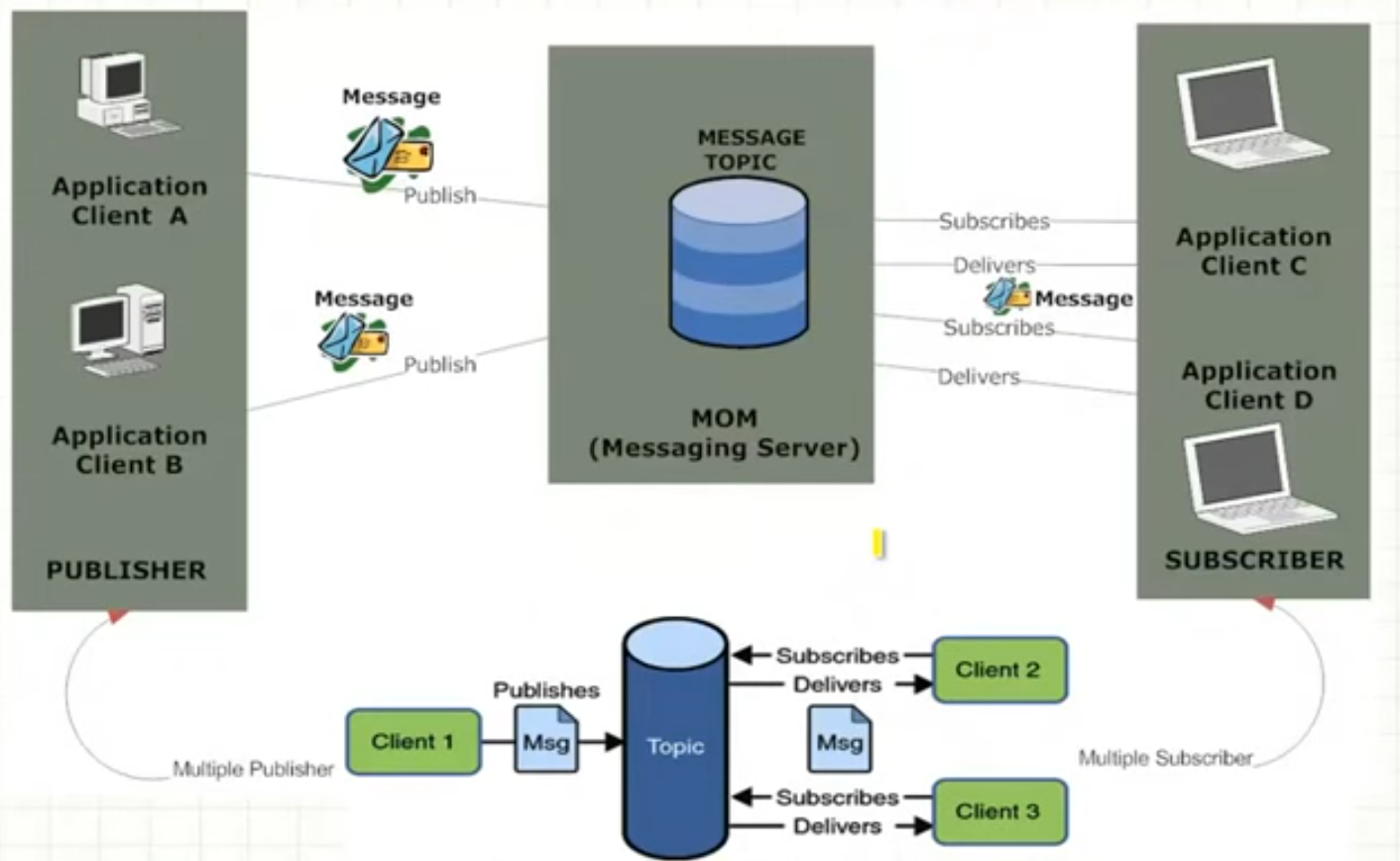
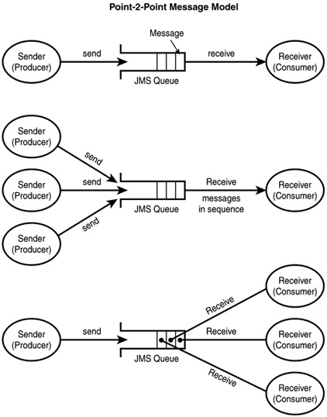
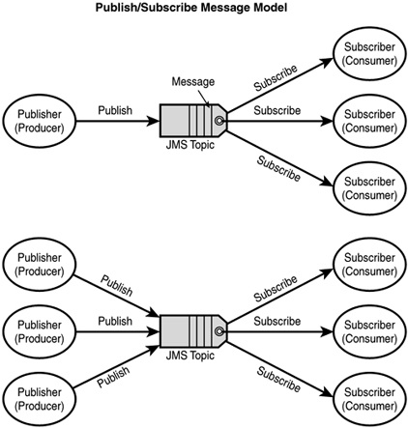
PTP vs PUB/SUB

Slide 24
PTP vs PUB/SUB
Point-to-Point (Queue) | Publish-Subscribe (Topic)
Each message is addressed to a virtual channel known as Queue | Each message is addressed to a virtual channel know as Topic
One-to-One i.e. a message delivered by a producer is consumed by only one receiver | One-to-Many i.e. a message delivered by a producer (publisher) can be consumed by zero or more receivers (subscribers)
A queue can have multiple receivers, but each message is consumed by only one receiver | A topic can have multiple receivers and every receiver receives a copy of each message
Pull-based model i.e. client polls the queue for new messages and sends the request | Push-based model i.e. messages are broadcasted to all the subscribers without them having to poll the topic
Messages are retained in the queue until they are delivered to the receiver. The receiver can fetch the message even if it was not running when producer sent the messages. | Messages are retained in the topic until they are delivered to the “current“ subscribers. There is an option to have durable subscriptions in pub-sub model which allows the subscriber to dis-connect, reconnect again and collect the messages that were delivered when it was not active.
The receiver acknowledges the successful processing of a message. | Acknowledgment is optional.

Slide 25
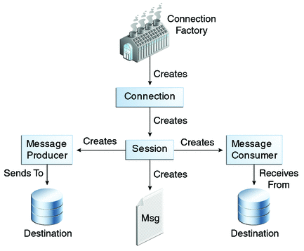
JMS API Programing Model
Connection factory -> Connection -> session->Message Producer/Consumer -> send/receive

Slide 26
JMS API Programing Model - Client
Setting up a connection and creating a session
InitialContext jndiContext=new InitialContext();
look up for the connection factory
ConnectionFactory cf=jndiContext.lookup(connectionfactoryname);
create a connection
Connection connection=cf.createConnection();
create a session
Session session=connection.createSession(false,Session.AUTO_ACKNOWLEDGE);
create a destination object
Destination dest1=(Queue) jndiContext.lookup(“/jms/myQueue”); //for PointToPoint
Destination dest2=(Topic)jndiContext.lookup(“/jms/myTopic”); //for publish-subscribe
Connection factory -> Connection -> session->Message Producer/Consumer -> send/receive

Slide 27
JMS API Programing Model –Producer
Setup connection and create a session
Creating producer
MessageProducer producer=session.createProducer(dest1);
Send a message
Message m=session.createTextMessage();
m.setText(“just another message”);
producer.send(m);
Closing the connection
connection.close();
Connection factory -> Connection -> session->Message Producer/Consumer -> send/receive

Slide 28
JMS API Programing Model – Consumer (Synchronous)
Setup connection and create a session
Creating consumer
MessageConsumer consumer=session.createConsumer(dest1);
Start receiving messages
connection.start();
Message m=consumer.receive();
Connection factory -> Connection -> session->Message Producer/Consumer -> send/receive

Slide 29
JMS API Programing Model – Consumer (Asynchronous)
Setup the connection, create a session
Create consumer
Registering the listener
MessageListener listener=new myListener();
consumer.setMessageListener(listener);
MyListener should have onMessage()
public void onMessage(Message msg){
//read the massage and do computation
}
Connection factory -> Connection -> session->Message Producer/Consumer -> send/receive
Notes:
register the listener

Slide 30
Thank you

